Slide 1
Image Captioning using CNN and LSTM
Presented by,
Naheli MDS202126
Neha MDS202127
Nevetha MDS202128
Notes:
Hello Everyone, Today we are going to present on Image Caption Generation, an exciting and rapidly growing field in computer vision and natural language processing.

Slide 2
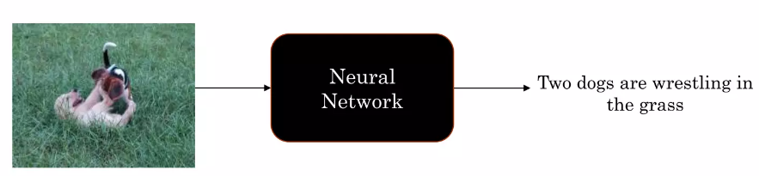
Introduction
Goal: To generate a descriptive sentence for a image.
Motivation:
To aid visually impaired
To generate video summary using individual frames.
Notes:
Image Caption Generation is the process of generating a textual description of an image that accurately reflects its content and context. It is an important technology with a wide range of potential applications.
For instance, it can assist visually impaired people in understanding the content of images, enhance the search engine's ability to retrieve images based on the text description, and improve social media platforms by generating more engaging and personalized captions for images.
However, generating accurate image captions poses significant challenges, including understanding the visual content of an image, encoding it into a meaningful representation, and generating a natural language description that captures its semantic and syntactic structures.
Fortunately, recent advances in deep learning, especially in the area of neural language modeling and attention mechanisms, have led to significant progress in image captioning.
In this presentation, we will cover the key concepts and techniques of image captioning, and the future directions of the field.

Slide 3
Text Preprocessing
Punctuation was removed from each token and was converted to lowercase
Hanging ‘s , a and tokens with number were removed
‘Start’ and ‘end’ was added at the beginning and end of each caption respectively
Each description is tokenized mapping each word to a unique id.
Notes:
Data preprocessing is a crucial step in image captioning as it affects the quality and accuracy of the generated captions.
In our approach, we employed several techniques to preprocess the textual data, including tokenization, cleaning, and mapping to unique IDs.
In our case, we removed punctuation from each token and converted them to lowercase, which reduces the vocabulary size and simplifies the task for the captioning model.
We also removed 's, a, and tokens with numbers, which are not relevant to the image content and can introduce noise to the captions.
To facilitate the captioning process, we added special tokens 'start' and 'end' at the beginning and end of each caption, respectively.
This helps the model to identify the start and end of the sentence and generate a more coherent and grammatically correct description.
Finally, each word was mapped to a unique ID, which allows the captioning model to represent the textual data in a numerical format that can be processed by deep learning models.
By preprocessing the textual data in this way, we were able to improve the quality and relevance of the generated captions.

Slide 4
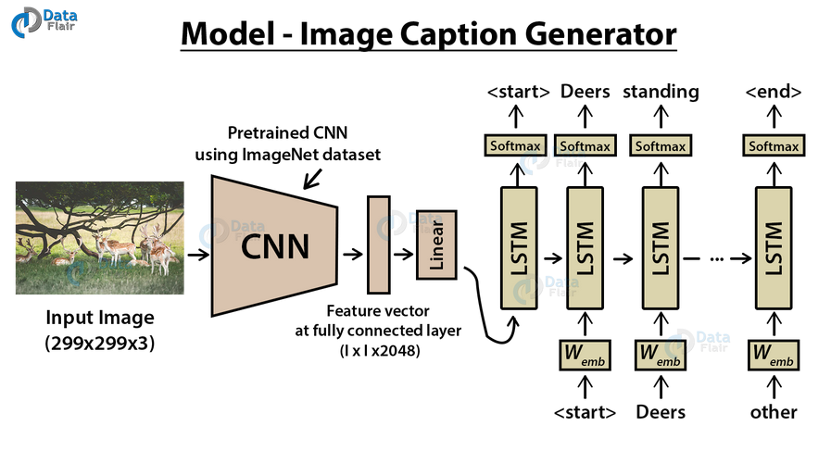
Image Caption Generator Architecture
Notes:
The image caption generator architecture is a deep learning model that takes an image as input and generates a descriptive caption.
Our model architecture consists of two main components, an encoder and a decoder, which work together to generate the captions.
The encoder is responsible for processing the visual information from the input image and generating a fixed-length feature vector representation.
The decoder is responsible for generating a caption from the feature vector representation obtained by the encoder.
The decoder is an LSTM-based language model that generates the caption word-by-word.
The input to the decoder is a sequence of word embeddings that correspond to the preprocessed caption.
The decoder generates the caption by predicting the probability distribution over the vocabulary for each word in the sequence.

Slide 5
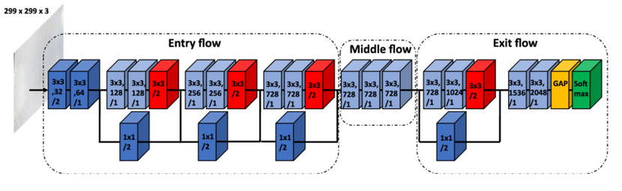
Image Feature Generation
Employed transfer learning using Xception and VGG-16
Images were resized according to the respective model architecture
Xception - (299,299,3)
VGG-16 - (224,224,3)
Fully connected networks were removed from both the models to generate a 2028 feature vector
Notes:
Now we’ll talk about the first step of the architecture, image feature generation which uses transfer learning
Transfer learning has become a popular technique in computer vision due to its ability to leverage pre-trained models and adapt them to specific tasks.
In our image captioning approach, we employed transfer learning using two popular models, Xception and VGG-16.
Both models are trained on large-scale image classification datasets, such as ImageNet, and have shown high performance in various computer vision tasks.
To use Xception and VGG-16 for image captioning, we resized the input images according to the respective model architecture.
Xception is more computationally efficient and can achieve higher accuracy on many tasks, while VGG-16 has a simpler architecture and is easier to train and interpret.
For Xception, the input image size was set to (299, 299, 3), while for VGG-16, it was set to (224, 224, 3).
We removed the fully connected layers from both models and extracted the output of the last convolutional layer, which resulted in a 2028 feature vector for each image.
These feature vectors serve as the input to the captioning model, which generates a natural language description of the image.

Slide 6
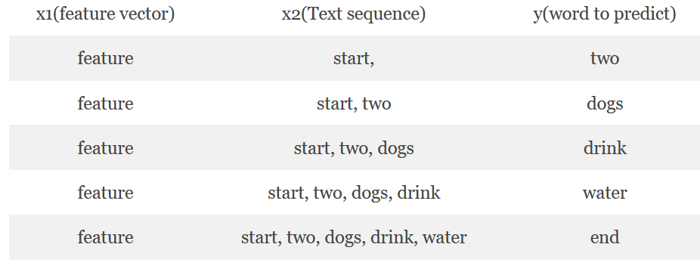
Sequential Caption Injection
The input to our model is [x1, x2] and the output will be y.
x1 is the 2048 feature vector of that image, x2 is the input text sequence
y is the output text sequence that the model has to predict.
Notes:
The input to the model is a combination of two elements, x1 and x2, and the output is y.
x1 is the 2048 feature vector extracted from the image using transfer learning. It serves as the visual input to the model.
x2 is the input text sequence, which is a preprocessed version of the caption. It is a sequence of words mapped to unique IDs and can be represented as a sequence of vectors.
Both x1 and x2 are fed into the model as input, which uses deep learning techniques to generate the output y.
The output y is the predicted text sequence that describes the image, and it is also preprocessed, mapped to unique IDs, and converted into a sequence of vectors.
The model uses an encoder-decoder architecture, where the input sequences are encoded into a fixed-size representation, and then the decoder generates the output sequence.
The model consists of multiple layers, including LSTM , which can capture the temporal dependencies and long-term structure of the input sequences.
By combining the visual input x1 and the textual input x2, the model can learn to generate captions that are not only relevant to the image content but also coherent and grammatically correct.

Slide 7
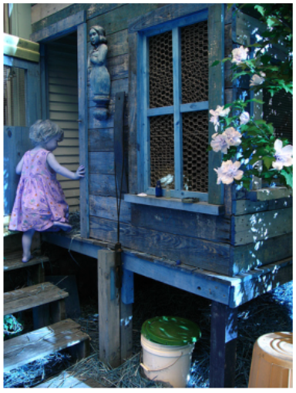
Dataset
We have used Flickr8K dataset
The dataset consists of various images depicting scenes and situations
The dataset contains 8000 images and each image contains 5 corresponding descriptions
The dataset had 6000 train images and 1000 test images
child in pink dress is climbing up set of stairs in an entry way
girl going into wooden building
little girl climbing into wooden playhouse
little girl climbing the stairs to her playhouse
little girl in pink dress going into wooden cabin
Notes:
We have use a popular benchmark dataset, flickr8K for image captioning. It consists of 8,000 images, each with five captions written by different annotators, making a total of 40,000 captions.
The dataset includes a train set of 6,000 images and a validation set of 1,000 images, which can be used for training and validation purposes. The test set contains the remaining 1,000 images and is used for evaluating the performance of the models.

Slide 8
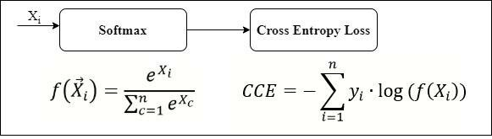
Evaluation Metrics
Categorical cross-entropy
Notes:
In image captioning, the evaluation metrics should take into account the variability in the language used to describe images.
One commonly used evaluation metric for image captioning is the classification cross entropy.
The classification cross entropy measures the difference between the predicted caption and the ground truth caption in terms of word probabilities.
It is a standard metric used in natural language processing tasks that involve predicting the probability distribution over a set of words.
The classification cross entropy penalizes the model more for incorrectly predicting rare words in the ground truth caption.

Slide 9
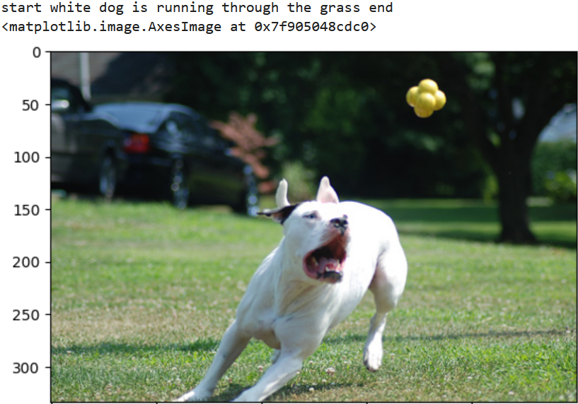
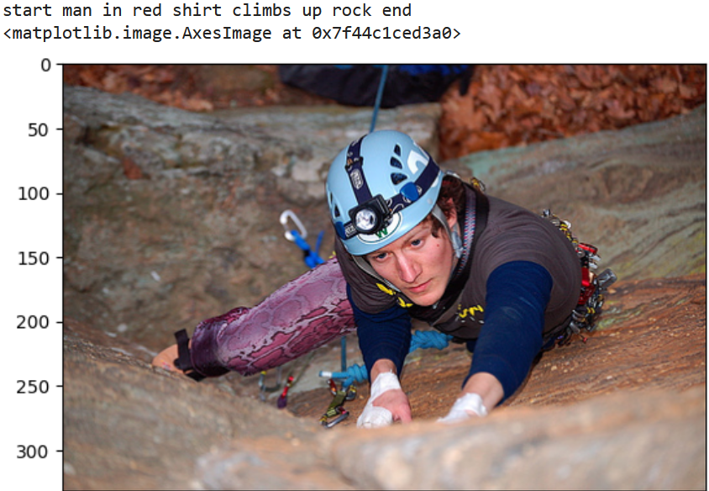
Results
Correct Predictions

Slide 10
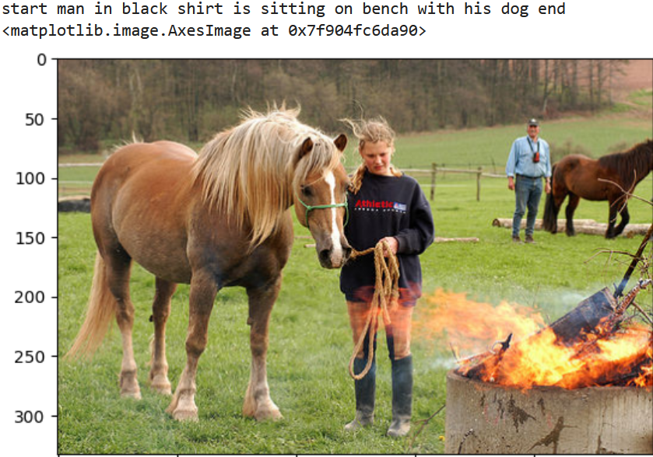
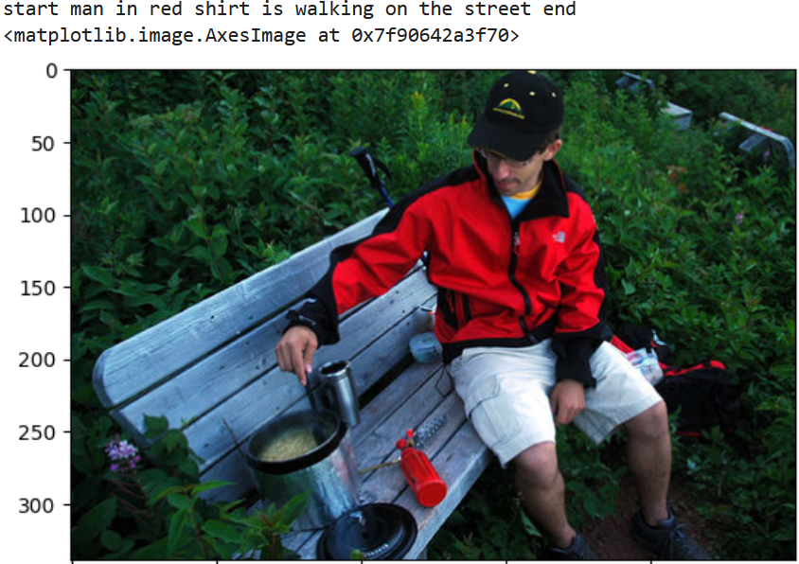
Results
Funny Results

Slide 11
Conclusion
As image captioning continues to evolve, we can expect to see more applications of this technology in areas such as image search, content generation, and accessibility for the visually impaired.
Further Scope:
Multimodal image captioning
Fine-grained image captioning
Cross-lingual image captioning
Notes:
Multimodal image captioning: incorporating other modalities such as audio or text to generate captions for images.
Fine-grained image captioning: generating captions that describe specific details within an image, such as the color or texture of an object.
Cross-lingual image captioning: generating captions in multiple languages for a given image.

Slide 12
THANK YOU

